Slide 1
IBM Applied Data Science Capstone
Analyzing towns in Karachi and identifying potential business opportunities

Slide 2
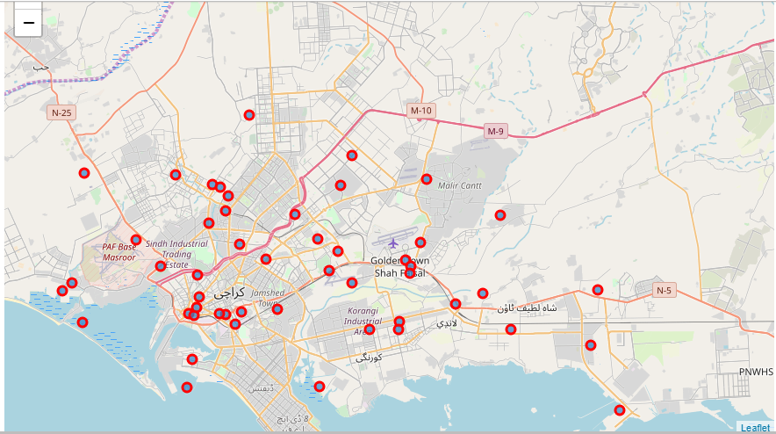

Slide 3
Business Problem
Karachi, despite being the biggest city and commercial hub of the country, very minimal amount of data available for it and what available is neither compact nor decision ready
Existing and new both businesses of any type are having problem in finding a place which is both economically viable and suit their business model
Several business and startups in the city have to research from scratch to find optimum locations or neighborhood for their product/services success with reasonable property valuation

Slide 4
Target Audience
This project can be utilized by several groups, mainly business owners and new startups also tourist and citizens can use this project to find places of any category near where they are
Government can also utilize this project to track a certain town growth and what measure the decision makers can take to further improve particular towns conditions and attractions

Slide 5
Data
Following data has been used to work on this plan
Postal Codes of all areas in Karachi
Population Statistics of each area
Property estimated Value of each area

Slide 6
Methodology
Includes:
Web scraping for relevant data
Data wrangling and cleaning (Tidy data format)
Use of Foursquare API
Data visualization using Folium, Waffle and WordCloud.
Applying unsupervised machine learning algorithm (DBSCAN)

Slide 7
Results
District Central is dominated by Fast food and Bakery, having the third highest population and No. of houses.
District Korangi is favored by Fast Food and Burger Joints with second highest domination in both population and No. of houses.
District West has most beaches as venues and is the most populated district both in term of population and houses
District South has most market and Hotels and has opportunity for future developments for both houses and population.
District East also dominated by Fast Food and Pizza and is moderately populated and has opportunity for future growth
District Malir has most Fast Food and Farm and has opportunity for future developments for both houses and population.

Slide 8
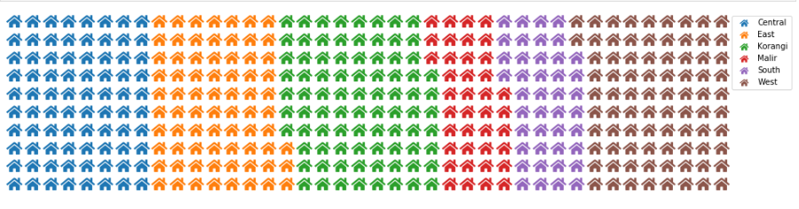
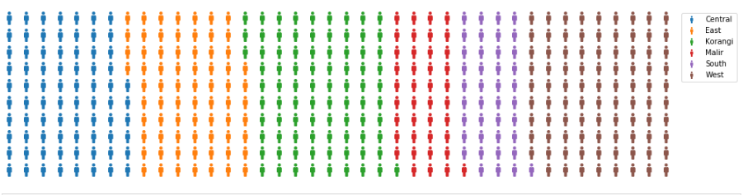

Slide 9
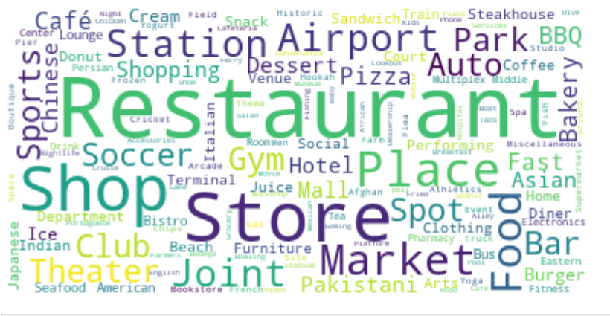

Slide 10
Discussion
It is been evident that restaurant is the most common venue of the city.
The result for each district and cluster wise provide insights that each district have different venue proportions.
The limitations in this report is that forsquare has only provided data points of major chains and popular venues and real number of venues might be much greater, for further research google api can be used for much broader analysis
Moreover, the unavailability of data for the city is biggest limitation as most of the time consumed is to find and put together the data

Slide 11
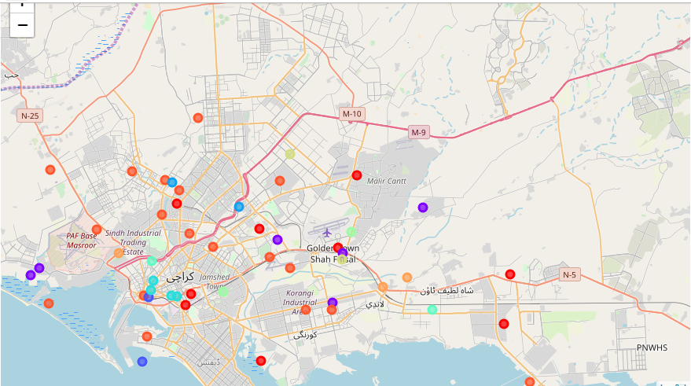
DBSCAN OUTPUT

Slide 12
Recommendations and Future Prospects
This Project can be further enhanced by adding real time data collaborating several companies
Also, government stake holders to check area wise real time monitoring of circulation of wealth, economics and potential business opportunity for any kind of business.

Slide 13
Conclusion
To conclude, Karachi’s each district has its own essence in terms of venues and by combining their analysis with DBSCAN it is indicated that what will be the feasible opportunity based on current venues in a cluster

Slide 14
Thankyou

